Slide 1
Lecture 9:
Understanding and Visualizing
Convolutional Neural Networks

Slide 2
Administrative
A1 is graded. We’ll send out grades tonight (or so)
A2 is due Feb 5 (this Friday!): submit in Assignments tab on CourseWork (not Dropbox)
Midterm is Feb 10 (next Wednesday)
Oh and pretrained ResNets were released today
(152-layer ILSVRC 2015 winning ConvNets)
https://github.com/KaimingHe/deep-residual-networks

Slide 3
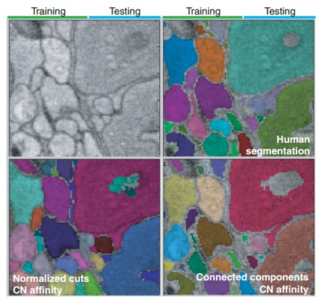
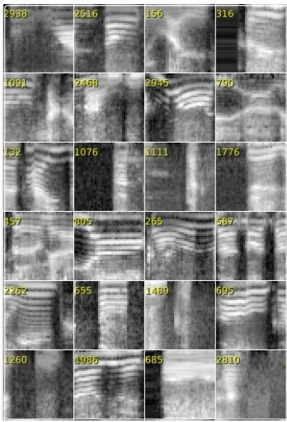
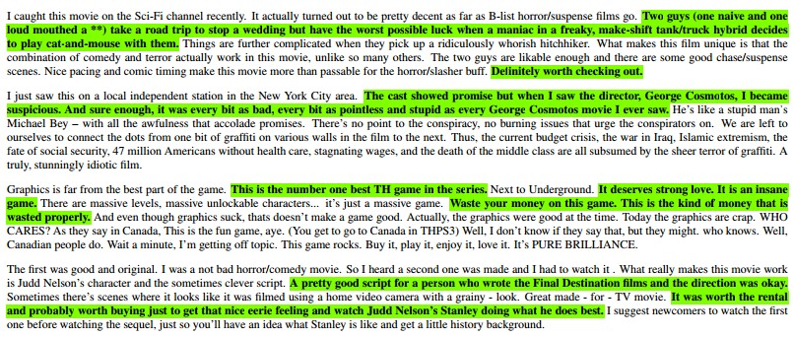
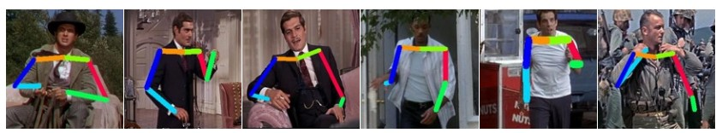
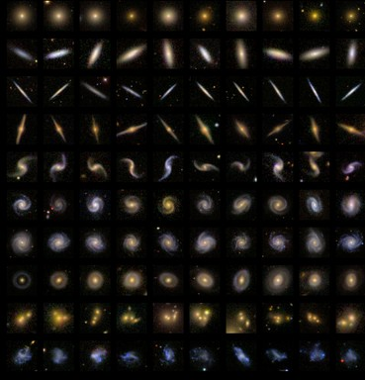
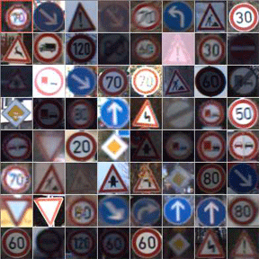
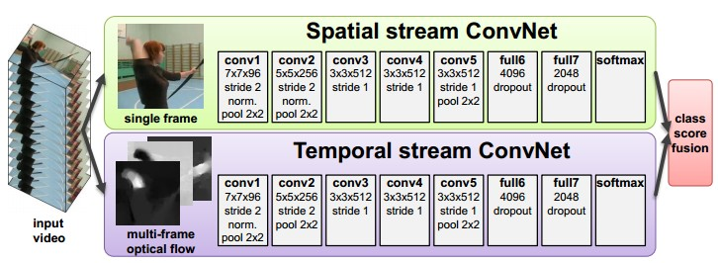
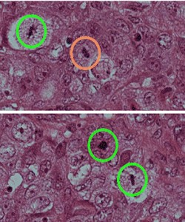
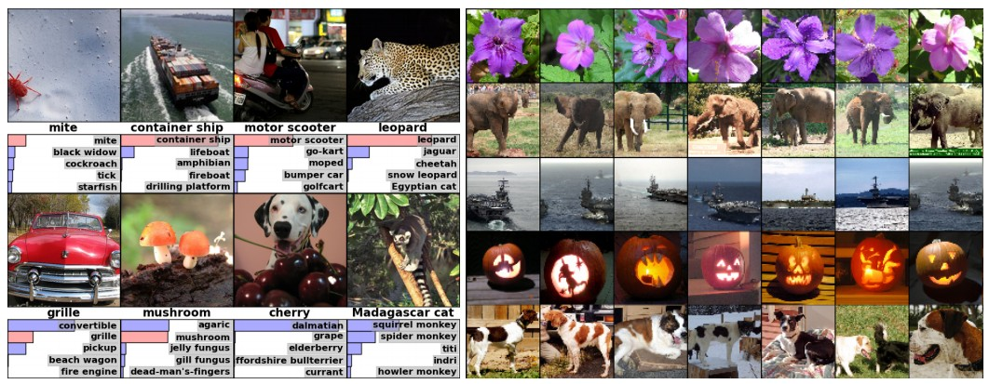
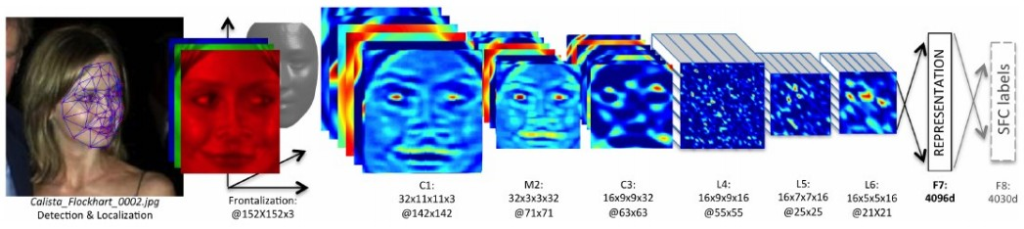
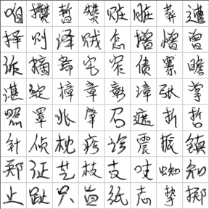
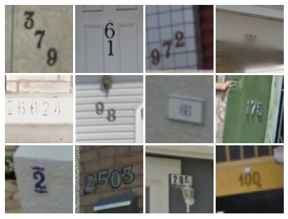
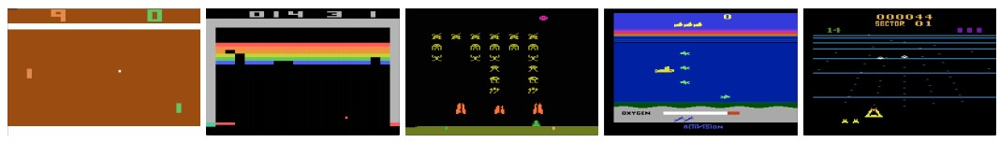

Slide 4
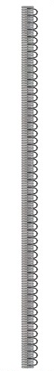
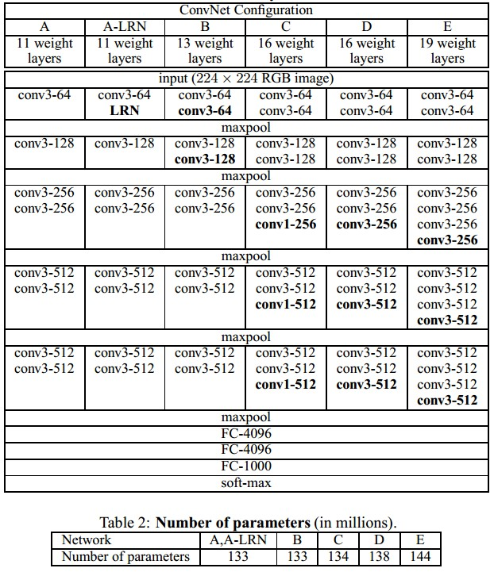


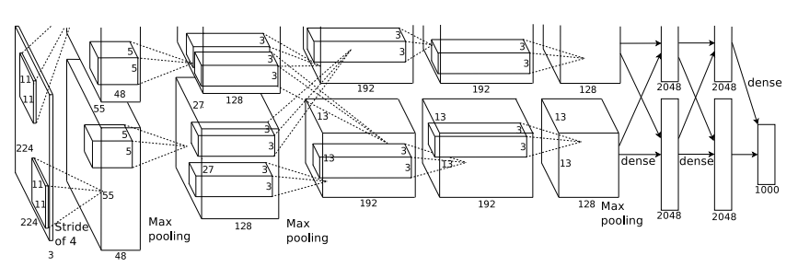
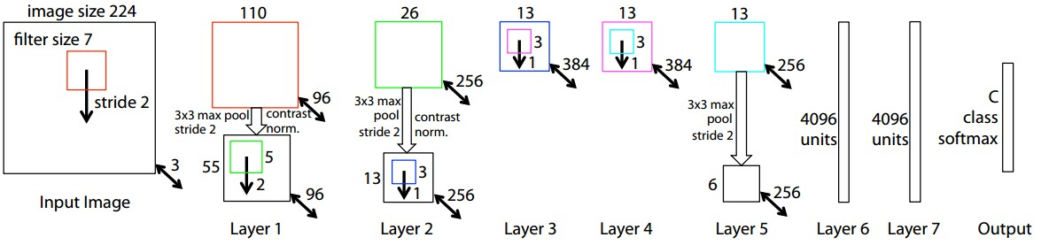
ConvNets

Slide 5
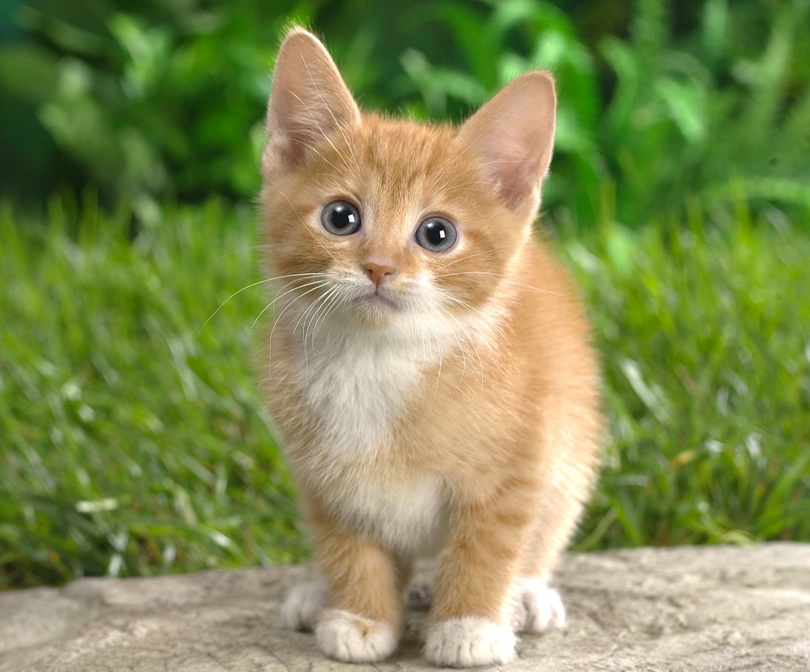
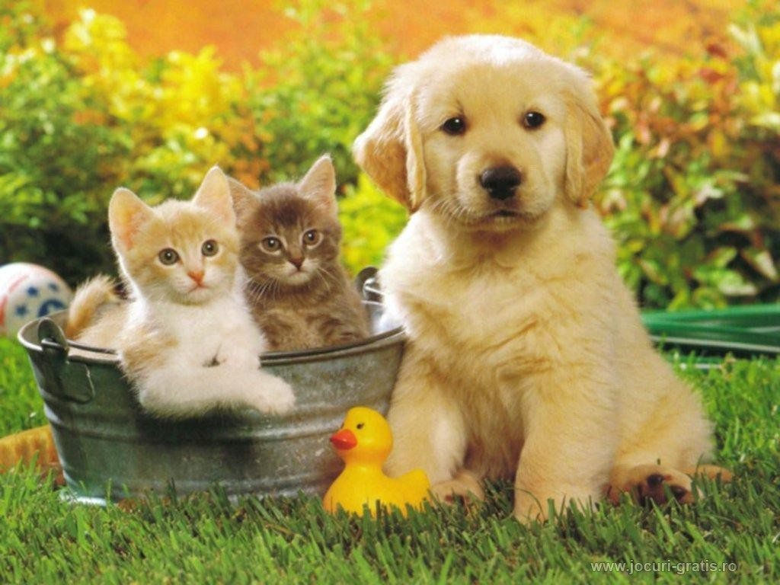
Computer Vision Tasks
Classification
Classification + Localization
Object Detection
Instance Segmentation
CAT
CAT
CAT, DOG, DUCK
CAT, DOG, DUCK
Single object
Multiple objects

Slide 6
Understanding ConvNets
Visualize patches that maximally activate neurons
Visualize the weights
Visualize the representation space (e.g. with t-SNE)
Occlusion experiments
Human experiment comparisons
Deconv approaches (single backward pass)
Optimization over image approaches (optimization)

Slide 7
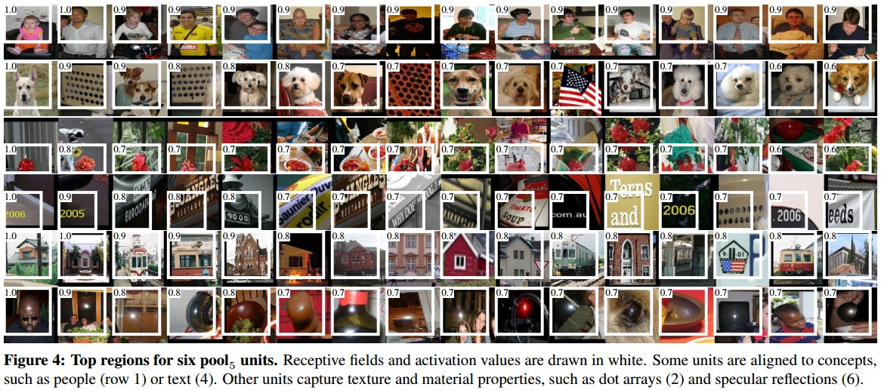
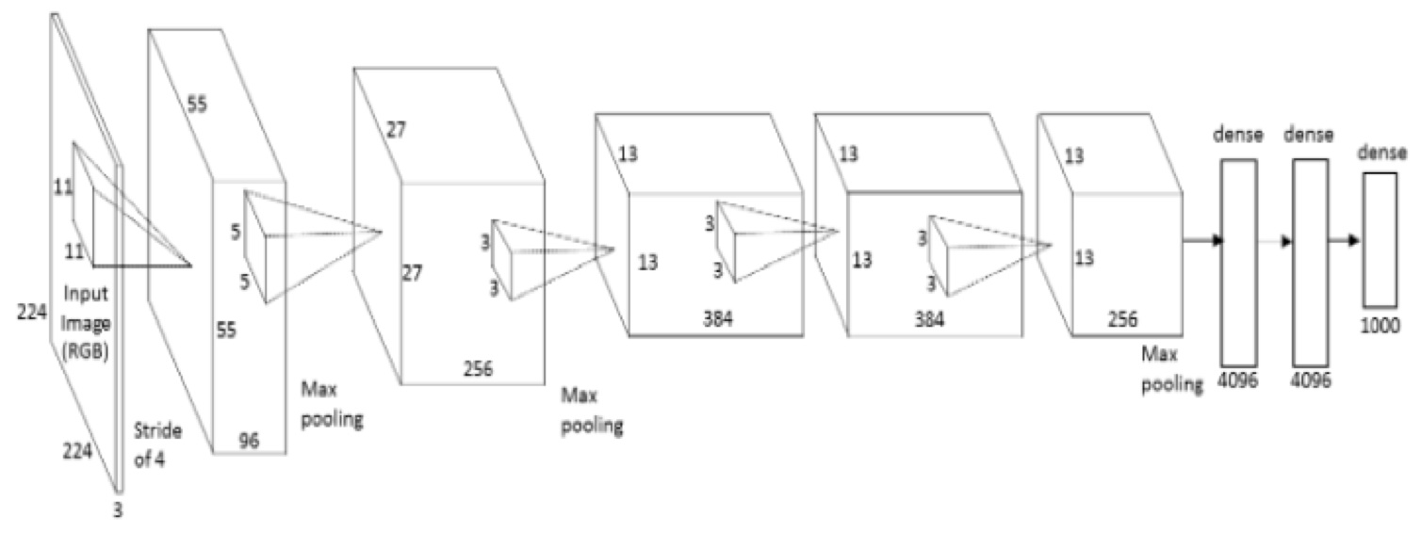
Visualize patches that maximally activate neurons
one-stream AlexNet
pool5
Rich feature hierarchies for accurate object detection and semantic segmentation
[Girshick, Donahue, Darrell, Malik]

Slide 8
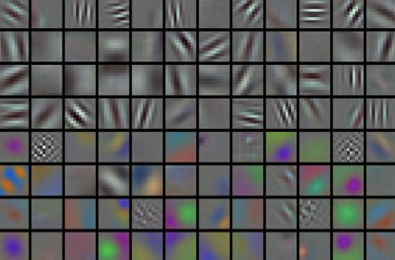
Visualize the filters/kernels (raw weights)
one-stream AlexNet
conv1
only interpretable on the first layer :(

Slide 9
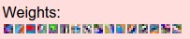
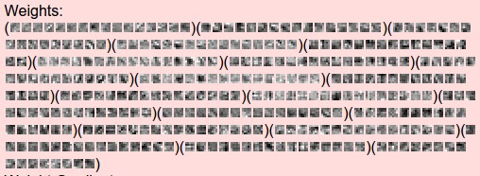
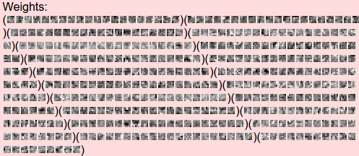
Visualize the
filters/kernels
(raw weights)
layer 1 weights
you can still do it for higher layers, it’s just not that interesting
(these are taken from ConvNetJS CIFAR-10 demo)
layer 2 weights
layer 3 weights

Slide 10
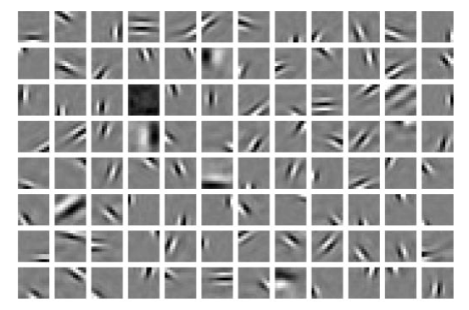
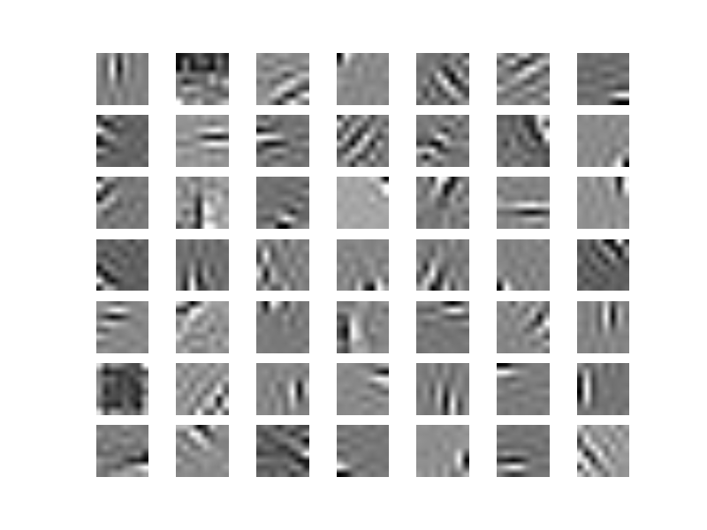
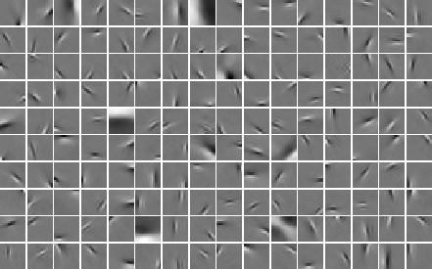
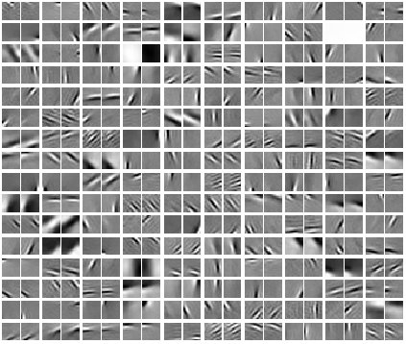
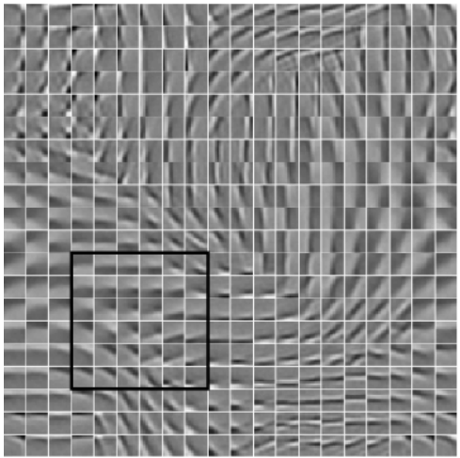
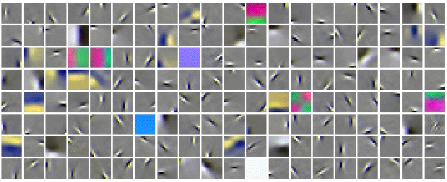
The gabor-like filters fatigue

Slide 11
Visualizing the representation
fc7 layer
4096-dimensional “code” for an image
(layer immediately before the classifier)
can collect the code for many images

Slide 12
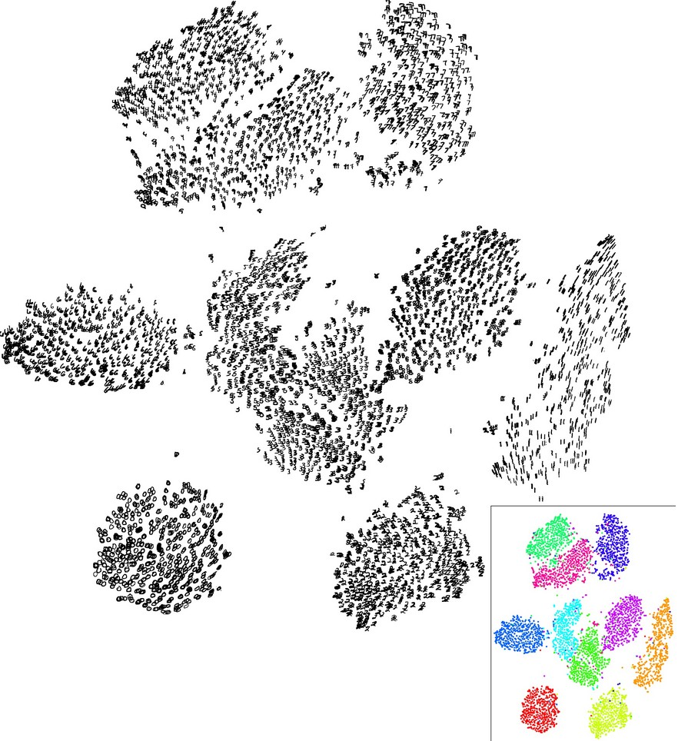
Visualizing the representation
t-SNE visualization
[van der Maaten & Hinton]
Embed high-dimensional points so that locally, pairwise distances are conserved
i.e. similar things end up in similar places. dissimilar things end up wherever
Right: Example embedding of MNIST digits (0-9) in 2D

Slide 13
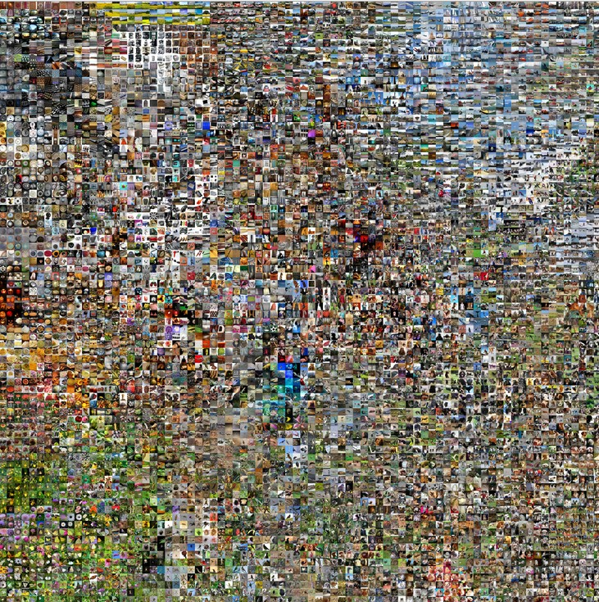
t-SNE visualization:
two images are placed nearby if their CNN codes are close. See more:
http://cs.stanford.edu/people/karpathy/cnnembed/

Slide 14
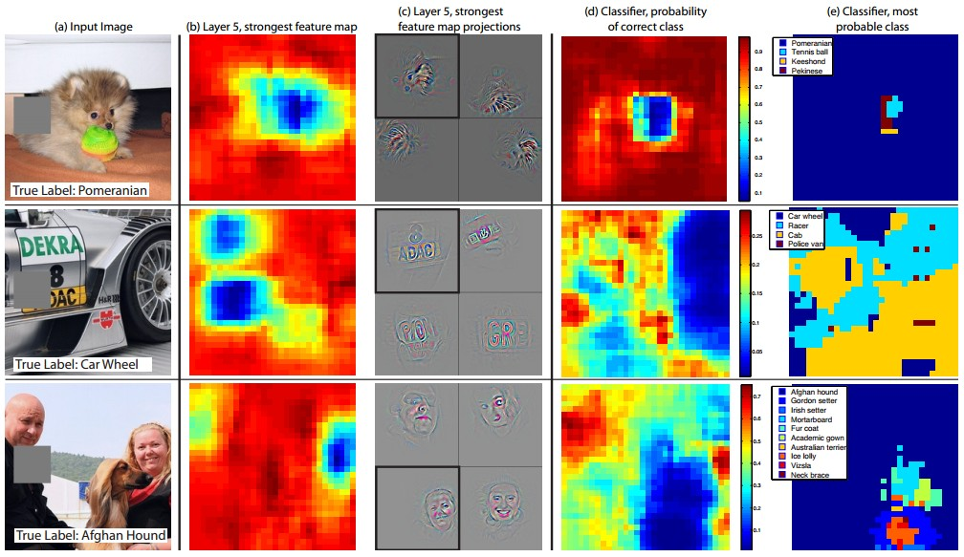
Occlusion experiments
[Zeiler & Fergus 2013]
(as a function of the position of the square of zeros in the original image)

Slide 15
Occlusion experiments
[Zeiler & Fergus 2013]
(as a function of the position of the square of zeros in the original image)

Slide 16
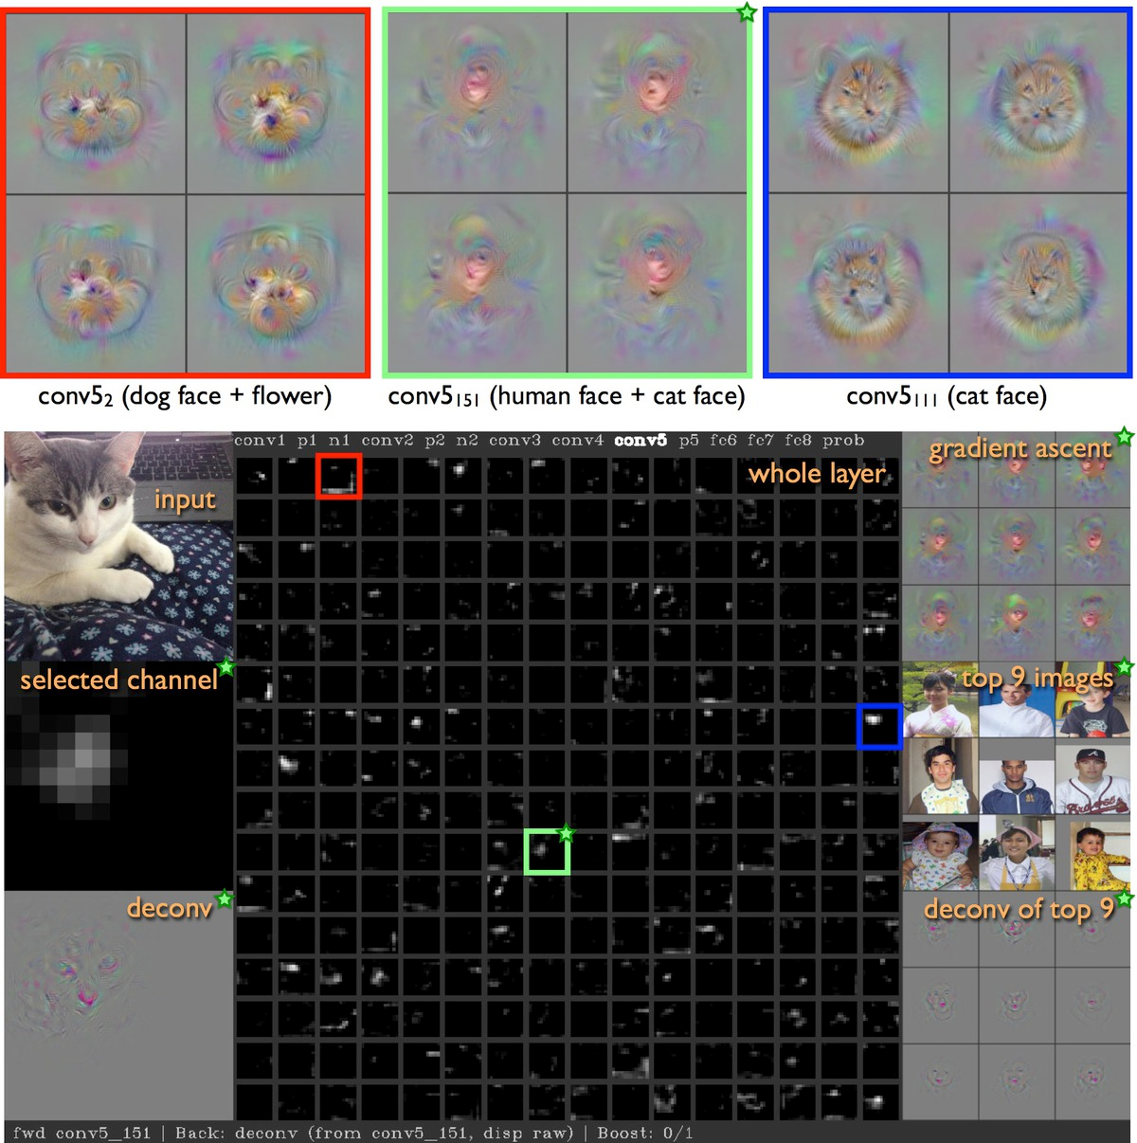
Visualizing Activations
http://yosinski.com/deepvis
YouTube video
https://www.youtube.com/watch?v=AgkfIQ4IGaM
(4min)

Slide 17
Deconv approaches
Feed image into net
Q: how can we compute the gradient of any arbitrary neuron in the network w.r.t. the image?

Slide 18
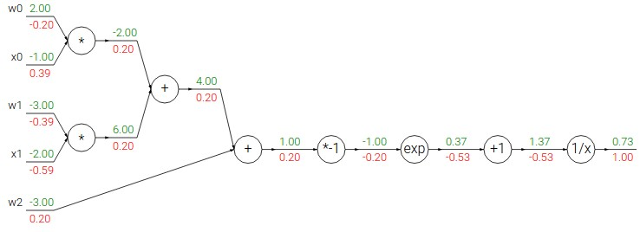
Deconv approaches
Feed image into net

Slide 19
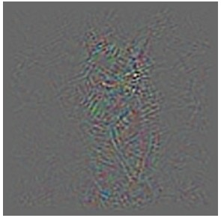
Deconv approaches
Feed image into net
2. Pick a layer, set the gradient there to be all zero except for one 1 for some neuron of interest
3. Backprop to image:

Slide 20
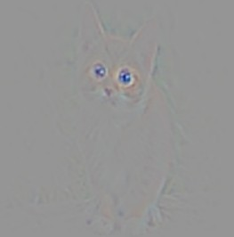
Deconv approaches
Feed image into net
2. Pick a layer, set the gradient there to be all zero except for one 1 for some neuron of interest
3. Backprop to image:
“Guided
backpropagation:”
instead

Slide 21
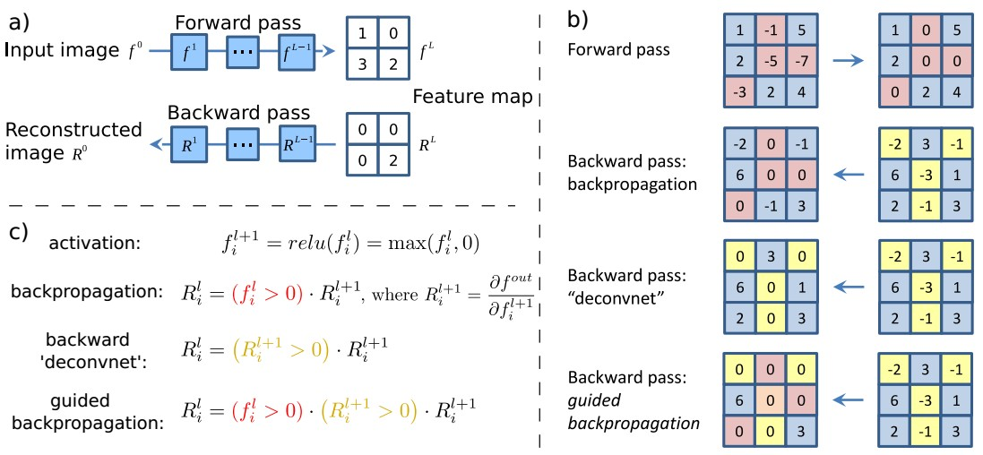
Deconv approaches
[Visualizing and Understanding Convolutional Networks, Zeiler and Fergus 2013]
[Deep Inside Convolutional Networks: Visualising Image Classification Models and Saliency Maps, Simonyan et al., 2014]
[Striving for Simplicity: The all convolutional net, Springenberg, Dosovitskiy, et al., 2015]

Slide 22
Deconv approaches
[Visualizing and Understanding Convolutional Networks, Zeiler and Fergus 2013]
[Deep Inside Convolutional Networks: Visualising Image Classification Models and Saliency Maps, Simonyan et al., 2014]
[Striving for Simplicity: The all convolutional net, Springenberg, Dosovitskiy, et al., 2015]
Backward pass for a ReLU (will be changed in Guided Backprop)

Slide 23
Deconv approaches
[Visualizing and Understanding Convolutional Networks, Zeiler and Fergus 2013]
[Deep Inside Convolutional Networks: Visualising Image Classification Models and Saliency Maps, Simonyan et al., 2014]
[Striving for Simplicity: The all convolutional net, Springenberg, Dosovitskiy, et al., 2015]

Slide 24
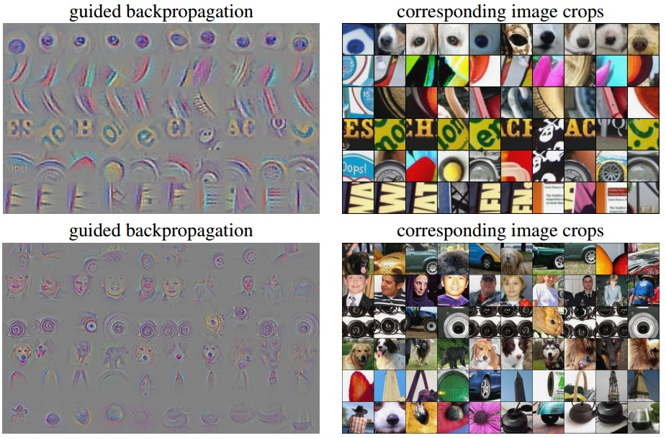
Visualization of patterns learned by the layer conv6 (top) and layer conv9 (bottom) of the network trained on ImageNet.
Each row corresponds to one filter.
The visualization using “guided backpropagation” is based on the top 10 image patches activating this filter taken from the ImageNet dataset.
[Striving for Simplicity: The all convolutional net, Springenberg, Dosovitskiy, et al., 2015]

Slide 25
Deconv approaches
[Visualizing and Understanding Convolutional Networks, Zeiler and Fergus 2013]
[Deep Inside Convolutional Networks: Visualising Image Classification Models and Saliency Maps, Simonyan et al., 2014]
[Striving for Simplicity: The all convolutional net, Springenberg, Dosovitskiy, et al., 2015]
bit weird

Slide 26
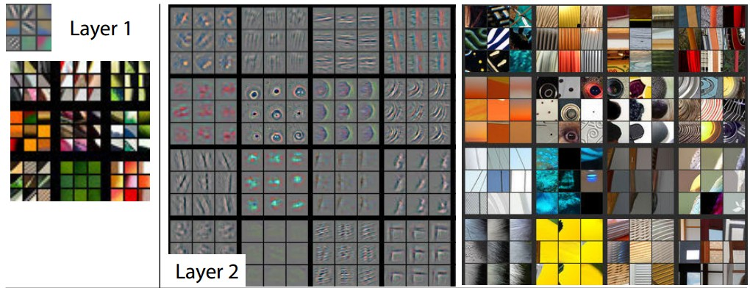
Visualizing and Understanding Convolutional Networks
Zeiler & Fergus, 2013
Visualizing arbitrary neurons along the way to the top...

Slide 27
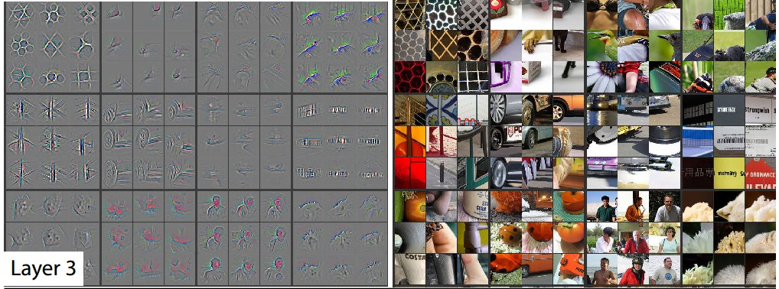
Visualizing arbitrary neurons along the way to the top...

Slide 28
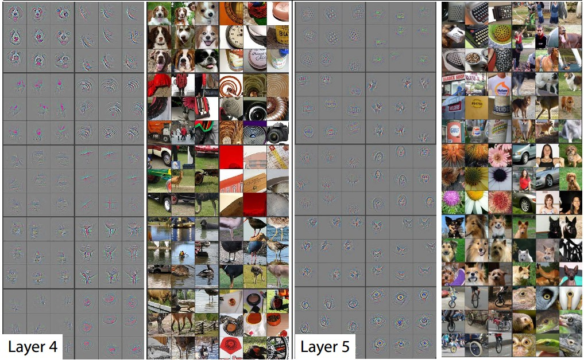
Visualizing arbitrary neurons along the way to the top...

Slide 29
Optimization to Image
Q: can we find an image that maximizes some class score?

Slide 30
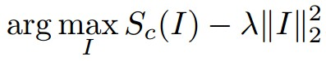
Optimization to Image
score for class c (before Softmax)
Q: can we find an image that maximizes some class score?

Slide 31
Optimization to Image
1. feed in zeros.
zero image
2. set the gradient of the scores vector to be [0,0,....1,....,0], then backprop to image

Slide 32
Optimization to Image
1. feed in zeros.
zero image
2. set the gradient of the scores vector to be [0,0,....1,....,0], then backprop to image
3. do a small “image update”
4. forward the image through the network.
5. go back to 2.
score for class c (before Softmax)

Slide 33
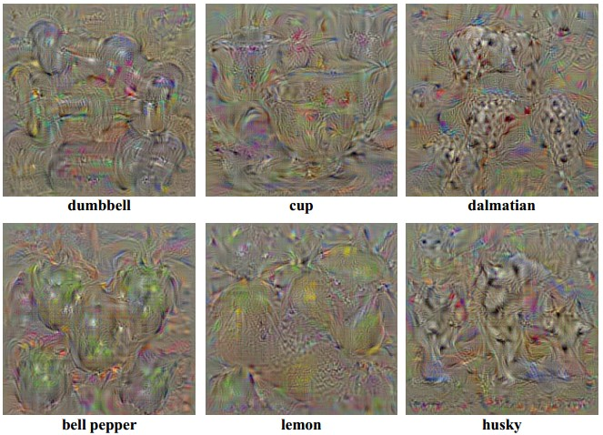
Deep Inside Convolutional Networks: Visualising Image Classification Models and Saliency Maps
Karen Simonyan, Andrea Vedaldi, Andrew Zisserman, 2014
Find images that maximize some class score:

Slide 34
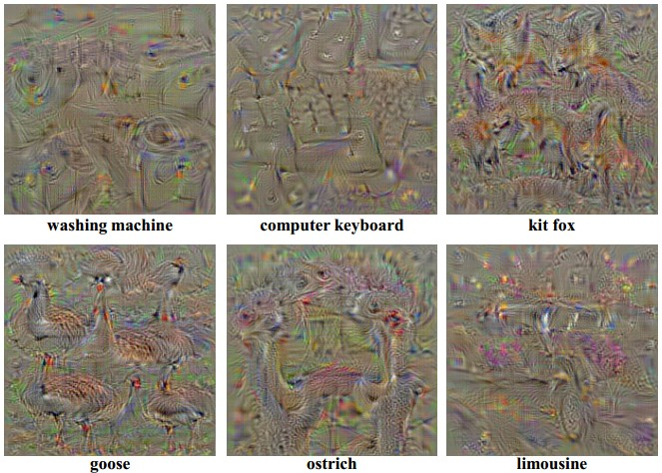
Deep Inside Convolutional Networks: Visualising Image Classification Models and Saliency Maps
Karen Simonyan, Andrea Vedaldi, Andrew Zisserman, 2014
Find images that maximize some class score:

Slide 35
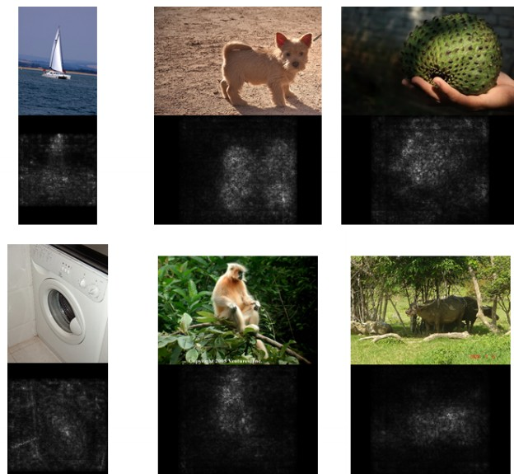
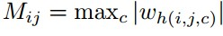
Deep Inside Convolutional Networks: Visualising Image Classification Models and Saliency Maps
Karen Simonyan, Andrea Vedaldi, Andrew Zisserman, 2014
2. Visualize the
Data gradient:
(note that the gradient on data has three channels. Here they visualize M, s.t.:
(at each pixel take abs val, and max over channels)
M = ?

Slide 36
Deep Inside Convolutional Networks: Visualising Image Classification Models and Saliency Maps
Karen Simonyan, Andrea Vedaldi, Andrew Zisserman, 2014
2. Visualize the
Data gradient:
(note that the gradient on data has three channels. Here they visualize M, s.t.:
(at each pixel take abs val, and max over channels)

Slide 37
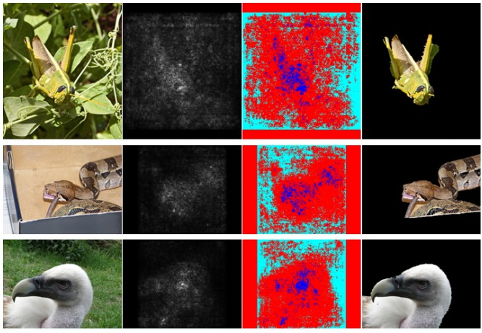
Deep Inside Convolutional Networks: Visualising Image Classification Models and Saliency Maps
Karen Simonyan, Andrea Vedaldi, Andrew Zisserman, 2014
Use grabcut for segmentation

Slide 38
We can in fact do this for arbitrary neurons along the ConvNet
Repeat:
Forward an image
Set activations in layer of interest to all zero, except for a 1.0 for a neuron of interest
Backprop to image
Do an “image update”

Slide 39
[Understanding Neural Networks Through Deep Visualization, Yosinski et al. , 2015]
Proposed a different form of regularizing the image
More explicit scheme:
Repeat:
Update the image x with gradient from some unit of interest
Blur x a bit
Take any pixel with small norm to zero (to encourage sparsity)

Slide 40
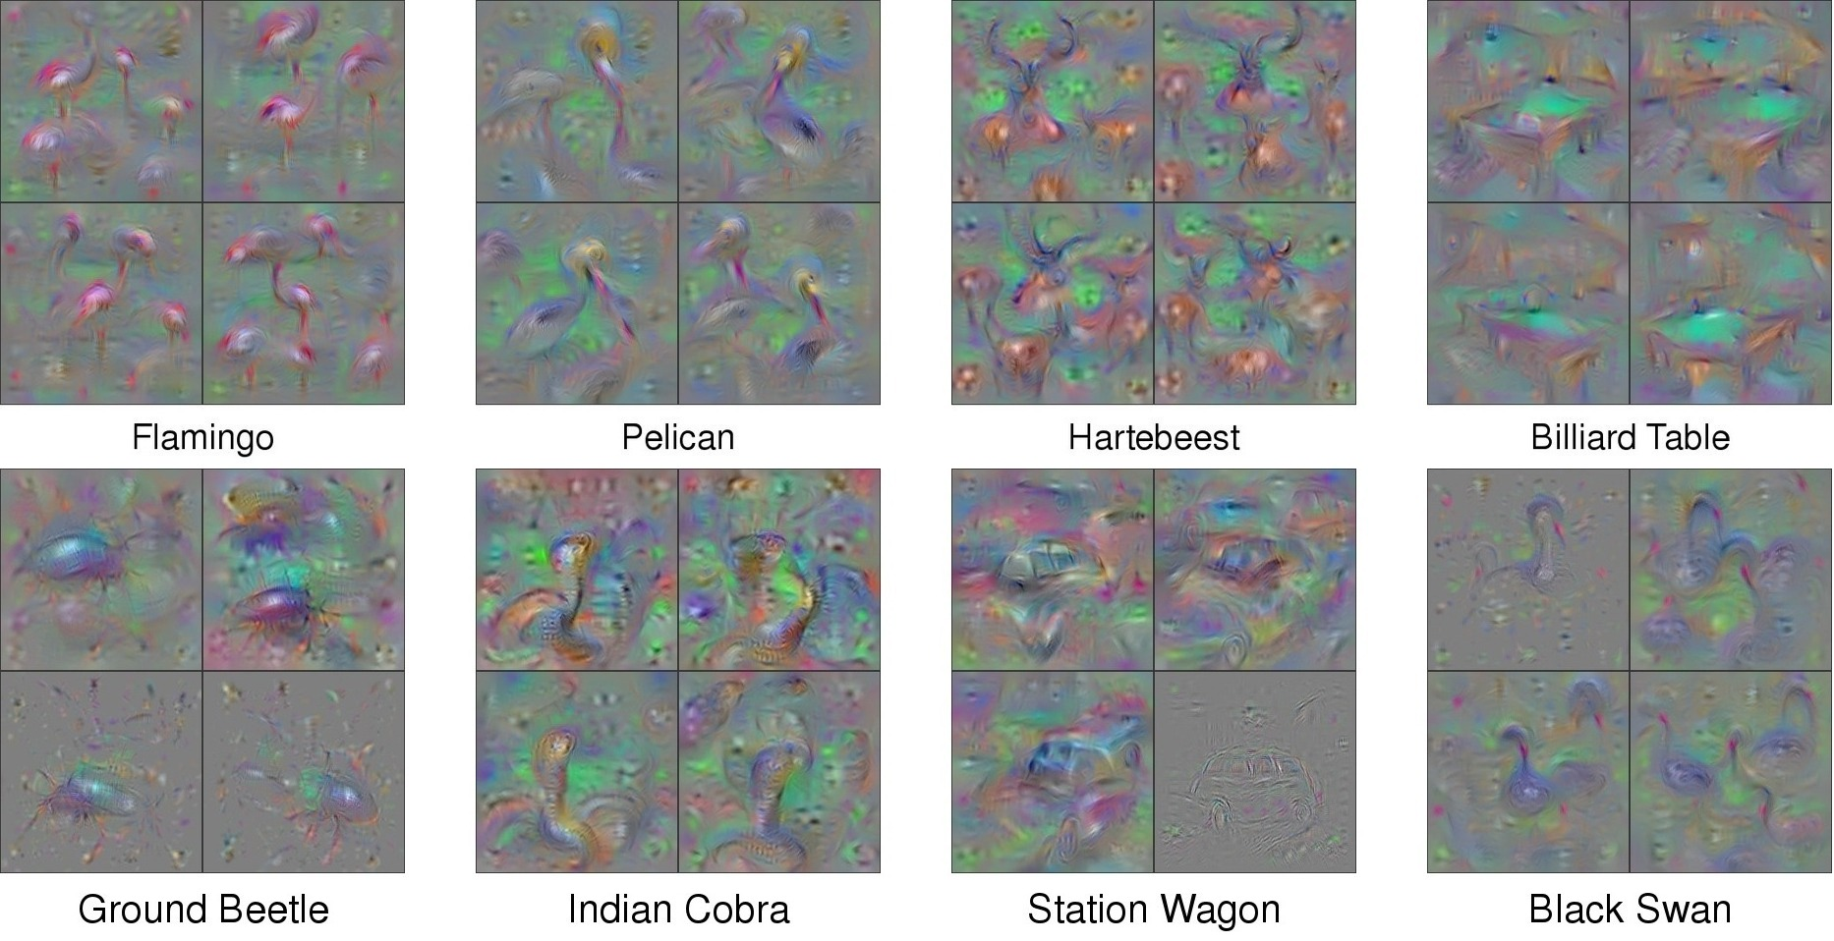
[Understanding Neural Networks Through Deep Visualization, Yosinski et al. , 2015]
http://yosinski.com/deepvis

Slide 41


Slide 44
Question: Given a CNN code, is it possible to reconstruct the original image?

Slide 45


Find an image such that:
Its code is similar to a given code
It “looks natural” (image prior regularization)

Slide 46

Understanding Deep Image Representations by Inverting Them
[Mahendran and Vedaldi, 2014]
original image
reconstructions
from the 1000 log probabilities for ImageNet (ILSVRC) classes

Slide 47

Reconstructions from the representation after last last pooling layer
(immediately before the first Fully Connected layer)

Slide 48


Reconstructions from intermediate layers

Slide 49


Multiple reconstructions. Images in quadrants all “look” the same to the CNN (same code)

Slide 50




DeepDream https://github.com/google/deepdream

Slide 51


Slide 52
DeepDream: set dx = x :)
jitter regularizer
“image update”

Slide 53


inception_4c/output
DeepDream modifies the image in a way that “boosts” all activations, at any layer
this creates a feedback loop: e.g. any slightly detected dog face will be made more and more dog like over time

Slide 54

inception_4c/output
DeepDream modifies the image in a way that “boosts” all activations, at any layer

Slide 55

inception_3b/5x5_reduce
DeepDream modifies the image in a way that “boosts” all activations, at any layer

Slide 56
Bonus videos
Deep Dream Grocery Trip
https://www.youtube.com/watch?v=DgPaCWJL7XI
Deep Dreaming Fear & Loathing in Las Vegas: the Great San Francisco Acid Wave
https://www.youtube.com/watch?v=oyxSerkkP4o

Slide 57



NeuralStyle
[ A Neural Algorithm of Artistic Style by Leon A. Gatys,
Alexander S. Ecker, and Matthias Bethge, 2015]
good implementation by Justin in Torch:
https://github.com/jcjohnson/neural-style

Slide 58







make your own easily on deepart.io

Slide 59
Step 1: Extract content targets (ConvNet activations of all layers for the given content image)
content activations
e.g.
at CONV5_1 layer we would have a [14x14x512] array of target activations

Slide 60
Step 2: Extract style targets (Gram matrices of ConvNet activations of all layers for the given style image)
style gram matrices
e.g.
at CONV1 layer (with [224x224x64] activations) would give a [64x64] Gram matrix of all pairwise activation covariances (summed across spatial locations)

Slide 61

Step 3: Optimize over image to have:
The content of the content image (activations match content)
The style of the style image (Gram matrices of activations match style)
(+Total Variation regularization (maybe))
match content
match style

Slide 62
We can pose an optimization over the input image to maximize any class score.
That seems useful.
Question: Can we use this to “fool” ConvNets?
spoiler alert: yeah

Slide 63


[Intriguing properties of neural networks, Szegedy et al., 2013]
correct
+distort
ostrich
correct
+distort
ostrich

Slide 64

[Deep Neural Networks are Easily Fooled: High Confidence Predictions for Unrecognizable Images
Nguyen, Yosinski, Clune, 2014]
>99.6% confidences

Slide 65

[Deep Neural Networks are Easily Fooled: High Confidence Predictions for Unrecognizable Images
Nguyen, Yosinski, Clune, 2014]
>99.6% confidences

Slide 66


These kinds of results were around even before ConvNets…
[Exploring the Representation Capabilities of the HOG Descriptor, Tatu et al., 2011]
Identical HOG represention

Slide 67

EXPLAINING AND HARNESSING ADVERSARIAL EXAMPLES
[Goodfellow, Shlens & Szegedy, 2014]
“primary cause of neural networks’ vulnerability to adversarial
perturbation is their linear nature“

Slide 68


Lets fool a binary linear classifier:
(logistic regression)

Slide 69
Lets fool a binary linear classifier:
x
2 | -1 | 3 | -2 | 2 | 2 | 1 | -4 | 5 | 1
-1 | -1 | 1 | -1 | 1 | -1 | 1 | 1 | -1 | 1
input example
w
weights

Slide 70
Lets fool a binary linear classifier:
x
2 | -1 | 3 | -2 | 2 | 2 | 1 | -4 | 5 | 1
-1 | -1 | 1 | -1 | 1 | -1 | 1 | 1 | -1 | 1
input example
w
weights
class 1 score = dot product:
= -2 + 1 + 3 + 2 + 2 - 2 + 1 - 4 - 5 + 1 = -3
=> probability of class 1 is 1/(1+e^(-(-3))) = 0.0474
i.e. the classifier is 95% certain that this is class 0 example.

Slide 71
Lets fool a binary linear classifier:
x
2 | -1 | 3 | -2 | 2 | 2 | 1 | -4 | 5 | 1
-1 | -1 | 1 | -1 | 1 | -1 | 1 | 1 | -1 | 1
? | ? | ? | ? | ? | ? | ? | ? | ? | ?
input example
w
weights
adversarial x
class 1 score = dot product:
= -2 + 1 + 3 + 2 + 2 - 2 + 1 - 4 - 5 + 1 = -3
=> probability of class 1 is 1/(1+e^(-(-3))) = 0.0474
i.e. the classifier is 95% certain that this is class 0 example.

Slide 72
Lets fool a binary linear classifier:
x
2 | -1 | 3 | -2 | 2 | 2 | 1 | -4 | 5 | 1
-1 | -1 | 1 | -1 | 1 | -1 | 1 | 1 | -1 | 1
1.5 | -1.5 | 3.5 | -2.5 | 2.5 | 1.5 | 1.5 | -3.5 | 4.5 | 1.5
input example
w
weights
adversarial x
class 1 score before:
-2 + 1 + 3 + 2 + 2 - 2 + 1 - 4 - 5 + 1 = -3
=> probability of class 1 is 1/(1+e^(-(-3))) = 0.0474
-1.5+1.5+3.5+2.5+2.5-1.5+1.5-3.5-4.5+1.5 = 2
=> probability of class 1 is now 1/(1+e^(-(2))) = 0.88
i.e. we improved the class 1 probability from 5% to 88%

Slide 73
Lets fool a binary linear classifier:
x
2 | -1 | 3 | -2 | 2 | 2 | 1 | -4 | 5 | 1
-1 | -1 | 1 | -1 | 1 | -1 | 1 | 1 | -1 | 1
1.5 | -1.5 | 3.5 | -2.5 | 2.5 | 1.5 | 1.5 | -3.5 | 4.5 | 1.5
input example
w
weights
adversarial x
class 1 score before:
-2 + 1 + 3 + 2 + 2 - 2 + 1 - 4 - 5 + 1 = -3
=> probability of class 1 is 1/(1+e^(-(-3))) = 0.0474
-1.5+1.5+3.5+2.5+2.5-1.5+1.5-3.5-4.5+1.5 = 2
=> probability of class 1 is now 1/(1+e^(-(2))) = 0.88
i.e. we improved the class 1 probability from 5% to 88%
This was only with 10 input dimensions. A 224x224 input image has 150,528.
(It’s significantly easier with more numbers, need smaller nudge for each)

Slide 74


Blog post: Breaking Linear Classifiers on ImageNet
Recall CIFAR-10 linear classifiers:
ImageNet classifiers:

Slide 75



mix in a tiny bit of
Goldfish classifier weights
+
=
100% Goldfish

Slide 77



Slide 78
EXPLAINING AND HARNESSING ADVERSARIAL EXAMPLES
[Goodfellow, Shlens & Szegedy, 2014]
“primary cause of neural networks’ vulnerability to adversarial
perturbation is their linear nature“
(and very high-dimensional, sparsely-populated input spaces)
In particular, this is not a problem with Deep Learning, and has little to do with ConvNets specifically. Same issue would come up with Neural Nets in any other modalities.

Slide 79
Summary
Backpropping to the image is powerful. It can be used for:
Understanding (e.g. visualize optimal stimuli for arbitrary neurons)
Segmenting objects in the image (kind of)
Inverting codes and introducing privacy concerns
Fun (NeuralStyle/DeepDream)
Confusion and chaos (Adversarial examples)

Slide 80


Next lecture:
Image Captioning
Recurrent Neural Networks
RNN Language Models

Slide 81
W1
ReLU
W2
ReLU
5
2
2
4
4
W3
-2
3
3
-2
0
5
1
-2
0
-3
0

Slide 82
In backprop: all +ve and -ve paths of influence through the graph interfere
W1
ReLU
W2
ReLU
5
2
2
4
4
W3
-2
3
3
-2
0
5
1
-2
0
-3
0
positive gradient, negative gradient, zero gradient

Slide 83
In guided backprop: cancel out -ve paths of influence at each step
(i.e. we only keep positive paths of influence)
W1
ReLU
W2
ReLU
5
2
2
4
4
W3
-2
3
3
-2
0
5
X
1
-2
0
-3
0
positive gradient, negative gradient, zero gradient

